Slide 1
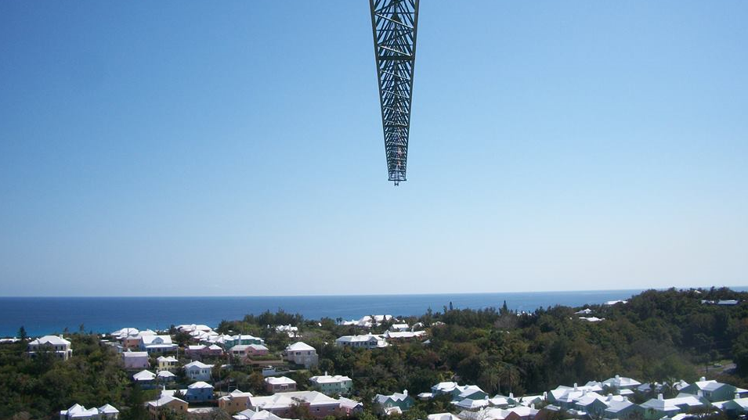
Crane Operators Association of Bermuda
BERMUDA CONSTRUCTION SAFETY COUNCIL

Slide 2
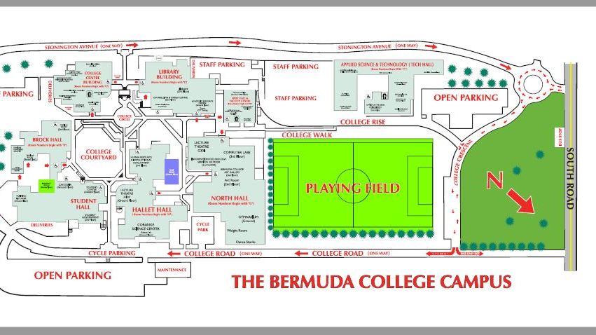
Faculty
Derreck Bean
Teresa Martin
Romeo Ruddock

Slide 3
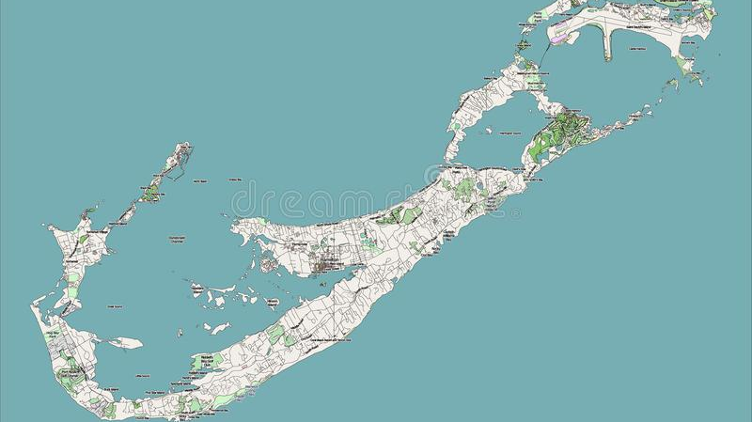
OSHA
Bermuda Occupational Safety & Health Act 1982
Bermuda Occupational Safety & Health Regulations 2009
Drug/Alcohol Free Workplace
START Training for all Site Supervision
Safety Meeting Attendance Mandatory
Orientations for all Site Workers 1st Day On Site
Daily Crew Stretch & Huddle Led by Foremen

Slide 4
Cultural Expectations
Workforce to be trained
Activity hazard analysis to be completed
Plan Safety into workplace
Supervisors are accountable for crew performance

Slide 5
Disciplinary Program
Company Red flags
Worker Three Strikes
No Tolerance: substance abuse, violence fall protection.
Positive Recognition Program
Certifications
Awards

Slide 6
Emergency Response
1st Aid kits
Fire Extinguishers
Exit routes
Muster Point
Closest medical Facility

Slide 7
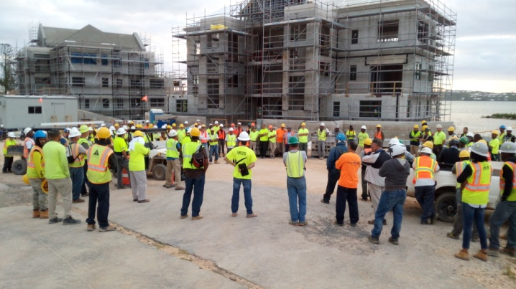
PERSONAL PROTECTIVE EQUIPMENT
Mandatory Personal Protective Equipment (P.P.E.)
Hard Hats (ANSI /CSA/BSEN)
Safety Glasses
High Visibility Clothing
Substantial Long Pants and Shirt w/Sleeves
Work Boots (Steel Toe i.e. No Tennis Shoes)
Task Specific P.P.E.:
Hand Protection (Glove Use Encouraged)
Double Eye Protection – Projectile Work Face Shields
Hearing Protection on Person (3’ Rule; Proper Use)
Respiratory Protection

Slide 8
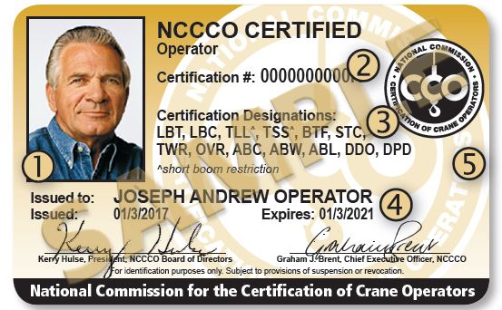
Certifications:
CPR & Standard First Aid
Vehicles –Licensed Drivers; Commercial DL
Crane Operator Cert. & Physical (Company/NCCCO)
Mechanized Equipment & Machinery Certifications
Competent Operator of Mechanized Equipment
Competent Person Requirements Fall Protection, Rigging, Aerial Lifts, etc.)

Slide 9
Module 1 – Types of Cranes
Hydraulic & Pneumatic
Tower Cranes
Mobile Cranes
Specialized Cranes

Slide 10
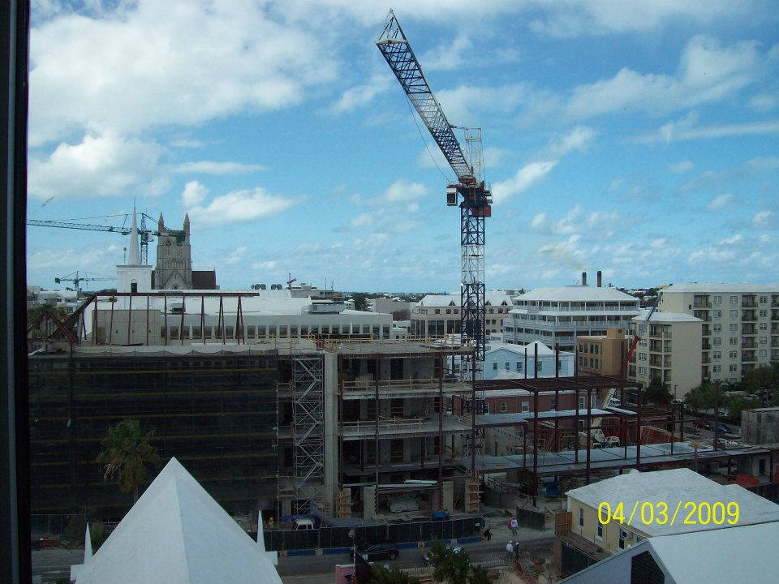
Tower Cranes

Slide 11
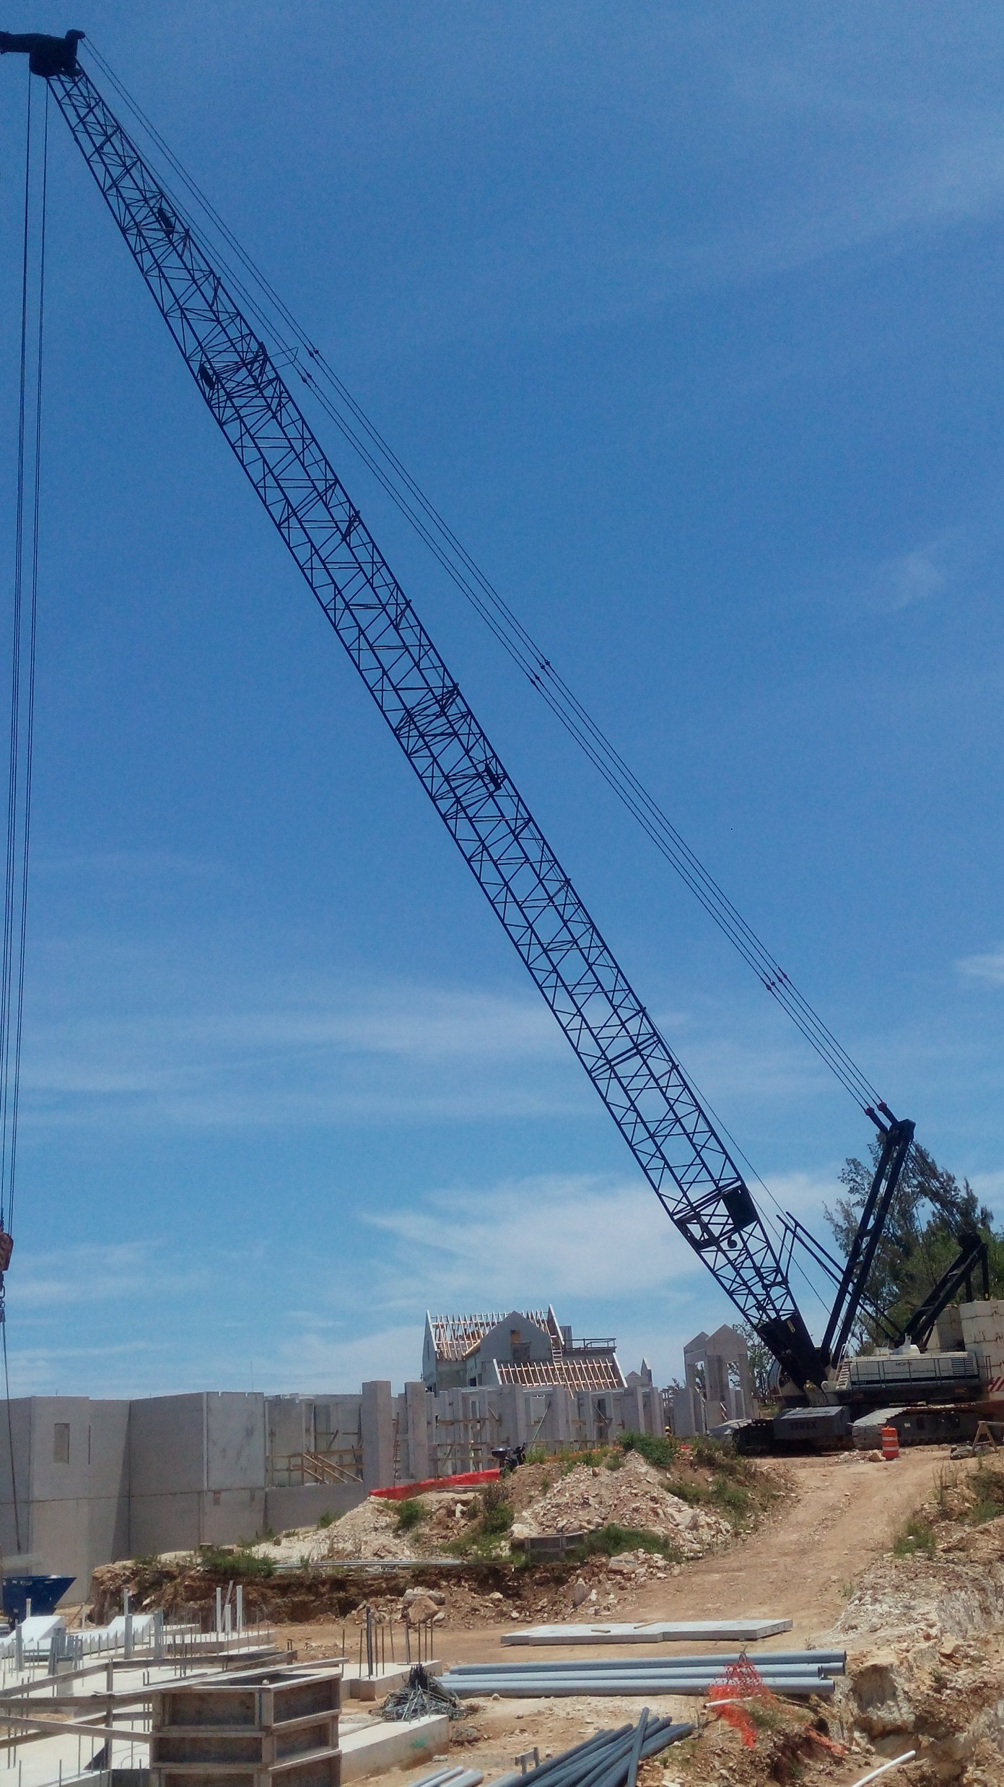
Mobile Crane

Slide 12
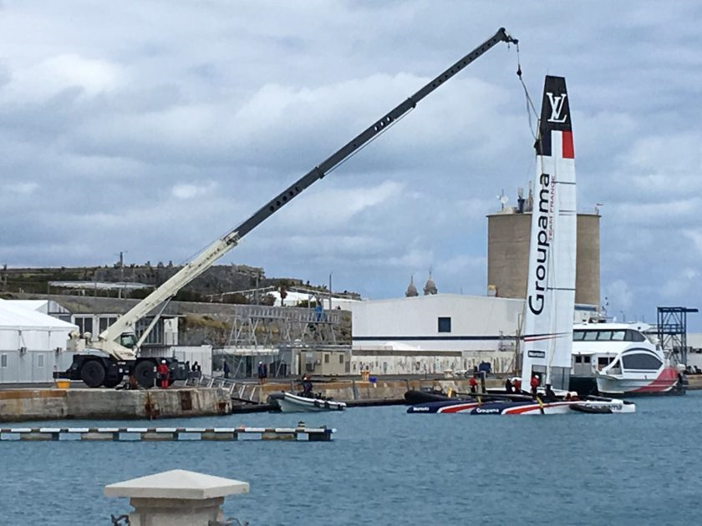
Mobile Crane

Slide 13
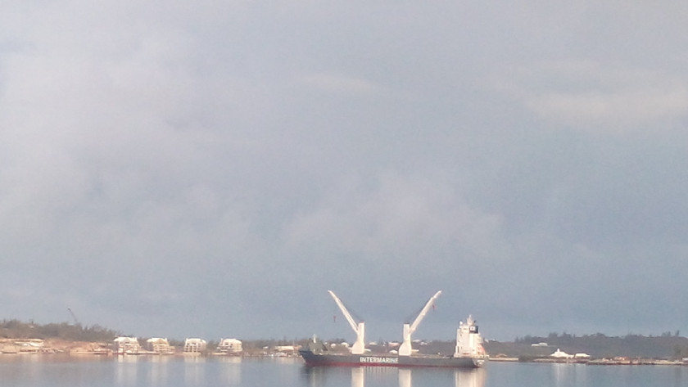
Specialized Construction

Slide 14
Module 2 – Employers/ees Responsibilities
Lift plan
AHA
Qualified Persons
Competent Persons

Slide 15
Module 3 – Ground Conditions
Stability
Mobilize
Demobilize

Slide 16
Module 4 – Power Line Safety
Electrical
High Voltage
Traveling under load

Slide 17
Module 5 – Inspections
Checksheets
Monthly
Annual

Slide 18
Module 6 – Wire Rope Conditions
Limited Access Zone
Rated Capacities
Proper spooling

Slide 19
Discuss with your members of your group current activity(s) about to start on your project. Pick and present three activities with their safety challenges to the rest of the group. Use your forms in your handouts.
Pick one activity of your group’s three activities. Provide a detailed list of needed safety actions for this activity. Present your findings to the rest of the group. Use your flipcharts.

