Slide 1
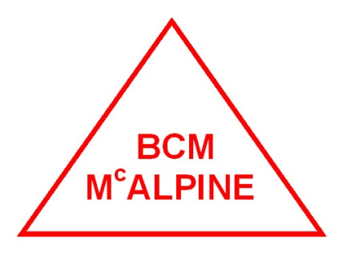
MEWP COURSE
Mobile
Elevated
Work
Platform

Slide 2
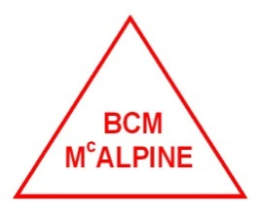
Warning !
Failure to Heed the following safety precautions could result in
Tip over
Falling
Crushing
Serious Injury
Death

Slide 3
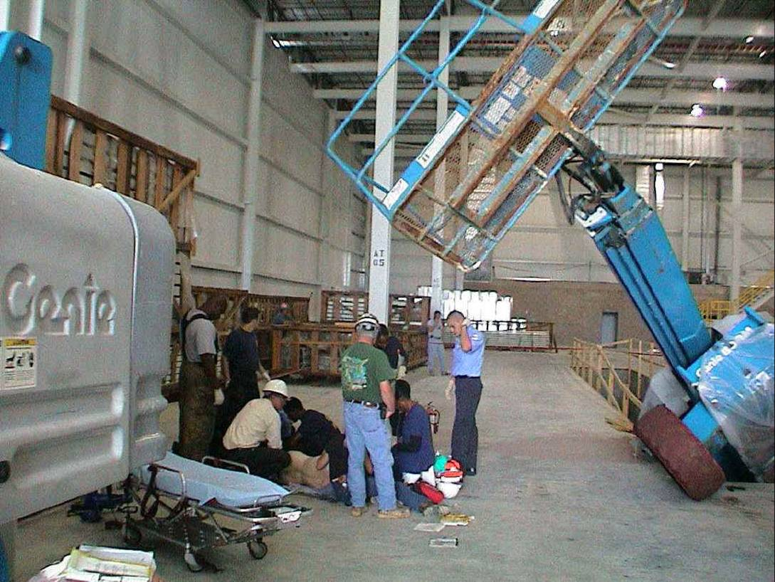
What Went Wrong?

Slide 4
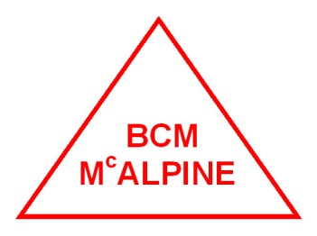
Safety Precautions
KNOW All Bermuda Occupational Safety and Health Act 2009 Parts 318 to 322 which apply to your Machine and Job site.
DO NOT leave the MEWP unattended with they key in the switch.
WEAR all the protective clothing and personal safety devices issued to you or called for by job conditions.
DO NOT wear loose clothing, neck ties, scarves, rings, wrist watches or other jewelry whilst operating the MEWP

Slide 5
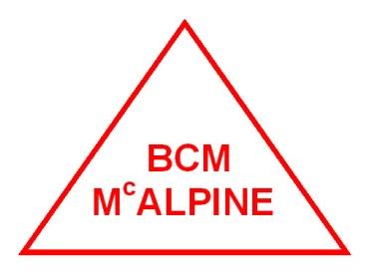
Safety Precautions
AVOID entanglement with ropes, cords or hoses
AVOID falling stay within the boundaries of the guard rails
DO NOT raise the MEWP in windy or gusty conditions
DO NOT increase the lateral surface of the platform increasing the area exposed to the wind
DO NOT drive or elevate the platform if it is not on a firm level surface do not elevate close to depressions or holes of any type that may effect the stability of the platform

Slide 6
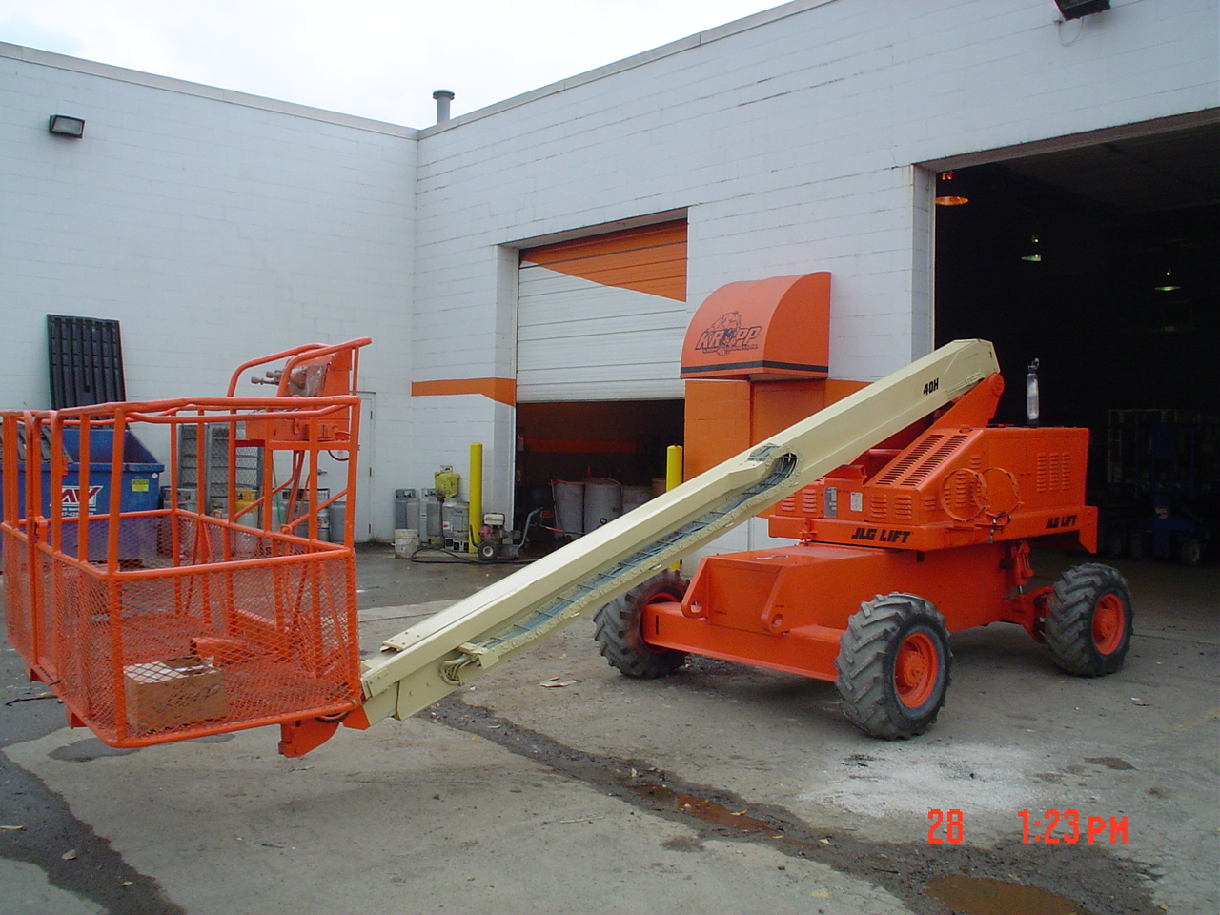
What Type of MEWP IS This?

Slide 7
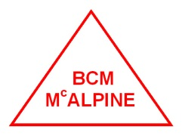
Safety Precautions
Operations Near To Drop Offs.
If this practice is absolutely necessary elevated driving is prohibited.
Position the MEWP horizontally and only elevate when the MEWP is stationary with out riggers positioned and the drive facility de activated.

Slide 8
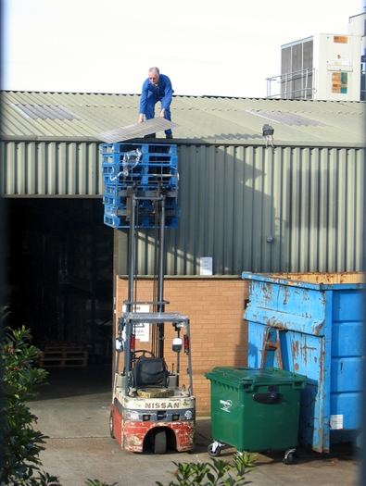
Does He Need A Scissor Lift

Slide 9
Safety Precautions
Elevated Driving must only be carried out on a firm level surface.
DO NOT Ascend or Descend gradients when gradient is steeper than 23%.
DO NOT operate on surfaces not capable of holding the weight of the MEWP including rated load e.g. covers, drains and trenches.
DO NOT operate a MEWP that has ladders or other devices mounted on it to increase its height.

Slide 10
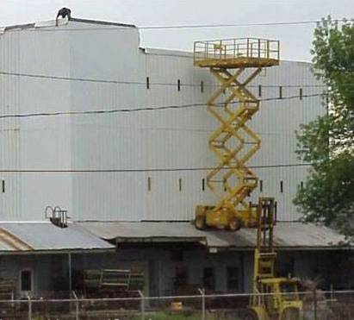
What do You Think?

Slide 11

Safety Precautions
DO NOT exert side forces on MEWP while elevated
DO NOT use MEWP as a crane it is prohibited
DO NOT climb on guard rails it is prohibited
DO NOT climb on the scissor assembly it is prohibited

Slide 12
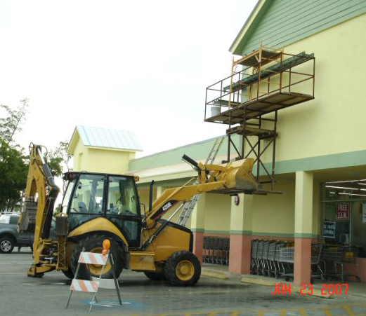
Right Machine For The JOB?

Slide 13

Safety Precautions
BE AWARE of obstructions or other possible hazards around the MEWP when driving or lifting.
DO NOT raise the MEWP while it is on the back of a delivery vehicle.
BE AWARE of crushing hazards keep all body parts inside the platform guard rails
DO NOT lower the platform unless the area below is clear of personnel

Slide 14
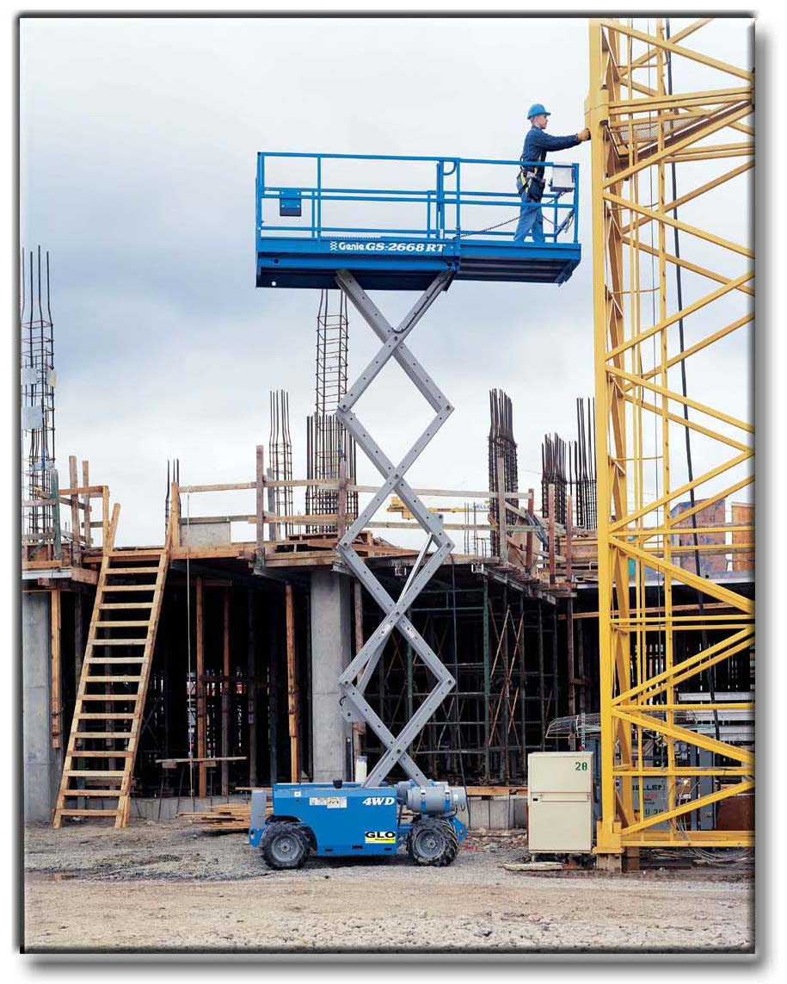
Correct Use Of a Scissor Lift ?

Slide 15
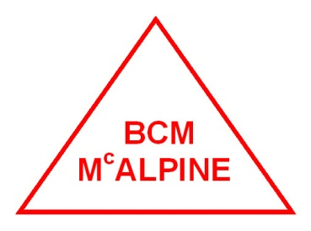
Safety Precautions
ENSURE that there are no personnel or obstructions in the path of travel, including blind spots.
BE AWARE of blind spots when operating the platform
DO NOT take part in any kind of horse play this is prohibited
ENSURE all pre use checks are carried out inline with the manufacturers instructions.
DO NOT use the Platform without guard rails lock pins and the chain gate bar in place

Slide 16
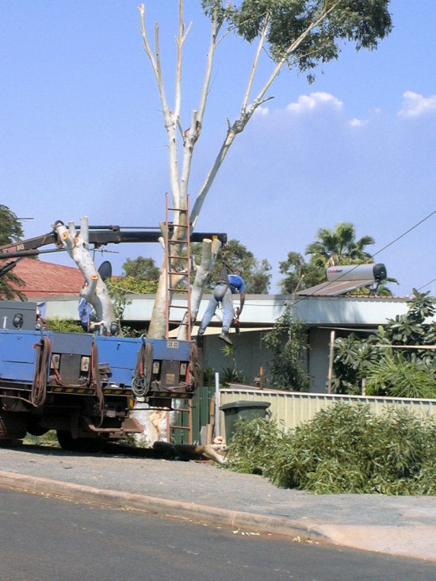
Improvisation?

Slide 17

Safety Precautions
DO NOT exceed the working capacity of the platform.
DO NOT use the platform if any defects are identified.
NOTIFY your superintendent of any maintenance issue immediately
DO NOT operate plant and machinery if you are under the influence of drugs prescription or none.
DO NOT operate the platform if you are under the influence of alcohol.

Slide 18
Harnesses
Harnesses must be worn at all times whilst operating a MEWP
Harnesses must have a restraint lanyard fitted
Harnesses must be inspected weekly or every time used
Harnesses must be connected to the anchor point in the MEWP

Slide 19
Practical Requirements
Operatives must Demonstrate the following.
Correct Pre use checks.
Correct mounting dismounting of MEWP.
Correct elevation and lowering of MEWP.
Correct use of harness in MEWP.
Correct driving of MEWP avoiding obstacles

