Slide 1

Infection Control
Prepared By: B. Harris
Reviewed By:
Approved By:
Revision 04/07/2020

Slide 2
Communication & Documentation
Introduction
Language Barriers
Literacy Issues
Proof of Training
Personal Identification

Slide 3

BCSC Infection Control Induction
All project staff undergo the BCSC Infection Control Induction.
IPAC (Infection Prevention & Control)
(Infection Prevention & Control Card) This Induction is valid for one year. Your new attendance card is proof of training and should always be kept ready for inspection.
Updates to changing standards requires training needs to be updated.

Slide 4

Legislation
Bermuda Occupational Safety & Health Act 1982
Bermuda Occupational Safety & Health Regulations 2009

Slide 5
Standards
CSA Standards “CAN/CSA Z317.13-07; Infection Control During the Construction, Renovation and Maintenance of Health Care Facilities”.
In the USA, Hospital Acquired Infections Of 34,890,768 hospital admissions an estimated 7-8000 are due to airborne pathogens (BUGS) released in construction and maintenance.

Slide 6
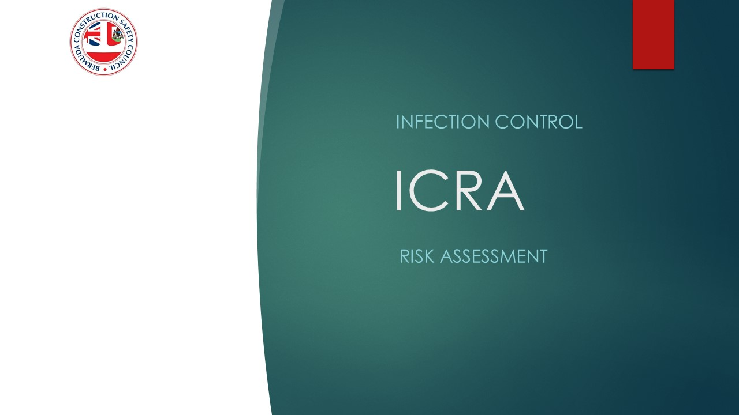
Infection Control Risk Assessment (ICRA)
What is it?
Who is responsible?
Where will it be posted?
Who is involved?
What is the importance of it?

Slide 7

INFECTION CONTROL RISK ASSESSMENT
ICRA Number: 000
Item | Hazard | Risk | Risk Class | # at Risk | Preventive Measures | Final Risk Class
2.
3.
4.
5.
Prepared or Reviewed By: | Accepted for use by: | Accepted by BCSC | Date:
Signed By: . .
Witnessed By: . .

Slide 8

Air Bourne Pathogens
In almost all cases, airborne pathogens cause an inflammatory reaction of the upper airways affecting the nose, sinuses, throat, and lungs.

Slide 9

Hazards
Dust is a sign that barriers are not working.
HEPA vacuums must be used.
Individually we are all responsible for ensuring our own working areas are as clean and free from trip hazards as possible.

Slide 10
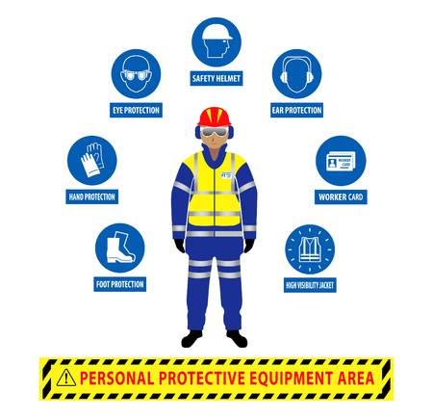
Personal Protective Equipment
Eye protection
Respiratory Protection
Ear Protection
Hand protection
Skin Protection

Slide 11
Personal Protective Equipment (P.P.E.)
Eye Protection (Safety Glasses)
Hand Protection Gloves (Neoprene)
Hearing Protection (3’ Rule; Proper Use)
Respiratory Protection (Respirator)
Skin Protection (Coveralls)

Slide 12

Hand hygiene policy
Practicing hand hygiene is a simple yet effective way to prevent infections. Cleaning your hands can prevent the spread of germs, including those that are resistant to antibiotics and are becoming difficult, if not impossible, to treat. On average, healthcare providers clean their hands less than half of the times they should. On any given day, about one in 31 hospital patients has at least one healthcare-associated infection.

Slide 13
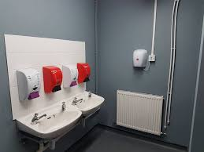
Welfare facilities should be kept in good order.

Slide 14

Drinking Water

Slide 15
Logistics
CAN/CSA-Z317.13.07
New Build Protocols
Shipping
Handling
Transportation of Materials and Equipment to the Project.
Shall be transported in a covered vehicle.
Protected from exposure to moisture and contaminants. Protected from exposure to moisture and contaminants.
High risk ductwork and Porous materials (Microbial Growth).
Correct handling procedures once on site.
Continue to protect and keep covered
Quality Assurance documentation from manufacturer to final placement

Slide 16
Conditions
Storage areas must be kept dust free, dry and clean.
Inspection on arrival with QA documentation.
Equipment and or materials shall be covered up until installation and inspected for further wipe down if required.
Ensure good house keeping practices are maintained at all times.

Slide 17
Inspect
Damaged Material
Assess damage.
Decontaminate or replace.
Return to manufacturer.

Slide 18

Quality Assurance

Slide 19

MSDS

Slide 20
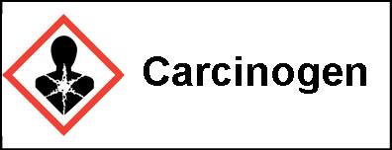
WARNING LABELS

Slide 21
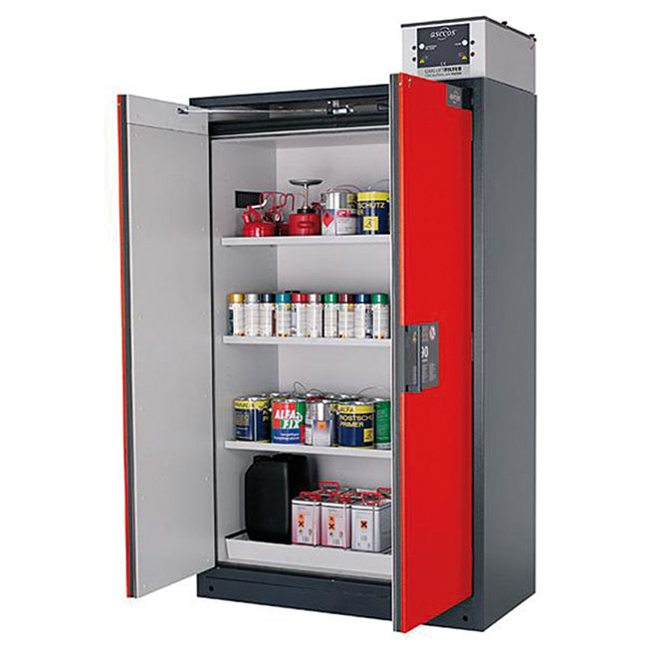
Storage

Slide 22

SAFETY

Slide 23

Above Ground
Only Standard Approved ladders shall be used. No work is to be done from the top two steps of a stepladder. Metal ladders shall not be used in proximity to electrical conductors. When above 6’6” workers are to be tied off with harness and /or a second man at the bottom of the ladder. ladder.
Aerial Lifts shall only be operated by certified workers. Workers are to fill out Daily check sheet. Workers are to be tied to anchor point with restraint lanyard.
The erection and dismantling of scaffolds and stages shall be carried out under the authorization of the erector.

Slide 24
First Aid/Accident Incident Reporting
First Aid Point
First Aid
Accident Book
First Aid point is located in the Project Office, Satellite First Aid Points on Site
All accidents must be recorded
Accident Reporting
Near Misses
Drug Taking Equipment
All accidents must be recorded into the accident book which is located in project office reception.

Slide 25
Fire Safety Plan / Emergency Procedures
If you hear an alarm you should treat it as a fire or an emergency. On hearing the alarm all project staff must report to assembly point.
No operatives are to re-enter until it has been deemed safe to do so by Fire & Security Manager.
It is important that all operatives attend the fire assembly point to enable a roll call to ensure everyone is safe and accounted for.

