Slide 1

BERMUDA CONSTRUCTION SAFETY COUNCIL
2021/2022
Submitted by:
Bermuda Construction Safety Council
15 North Court Ave.
Pembroke
Bermuda.
441-295-7882
www.bermudaconstructionsafetycouncil.com

Slide 2
Master Format
Bermuda Construction Safety Council
2020
DIVISION 1. HIGH RISK HAZARDS ………………………………….
  Falls
  Caught-in-between
  Struck by
DIVISION 2.
  AHA
  P.P.E.
  Equipment
DIVISION 3.
  MSDS
  Hazard Substances
  Hazard Communication
DIVISION 4.
  Scaffolding
  1st Aid
  Incident report
DIVISION 5. Metals
  Engineering controls
  Administrative control
  Record Keeping
DIVISION 6. Wood
  Struck by flying
  Fire
  Housekeeping
DIVISION 7. Thermal
  Record Keeping
  Site Survellence
DIVISION 8. Doors & Windows

Slide 3
Policy
Bermuda Construction Safety Council
2020
The Bermuda Construction Safety Council is focused on meeting the demands of the work force in all areas regarding their work life including education, work experience and healthy sporting activities. The council continues to meet at regular intervals at various locations around Bermuda with different themes and discussion topics and differing views can be met and disputes can be settled amicably. Anyone can sit in free of charge and have their voice heard as well as have their questions answered by local officials and authorities who have supported those types of initiatives.

Slide 4
What do we do?
The Bermuda Construction Safety Council has the following functions:
Ensuring the provision of essential safety services
Exercising regulatory responsibility over safety services
Regulating safety service providers and safety professionals
Licensing safety insurers and safety service providers
Identifying future challenges and goals for the safety culture
Regulating the cost of safety classes
Open communication with workers
Anticipation of hazards and pre planning, detecting unsafe acts
Record keeping, emergency response and action plans
Growth training and program implementation
Functions
Bermuda Construction Safety Council
2020
Section A

Slide 5
Education
Bermuda Construction Safety Council
2020
The Bermuda Construction Safety Council is focused on meeting the demands of the work force in all areas regarding their work life. The Council meets at regular intervals at different locations around the island with different themes and discussion topics in with anyone can sit and have their voice be heard as well as have their questions answered by local officials and authorities whom have supported. Disputes can be settled, and differing views can be met amicably. There is much focus on profit making especially in a country with high expenses however there is not much focus on legislation.
Bermuda is known to have a high quality of legislation however that information rarely reaches the day to day worker. We have made it our business to answer the questions of workers that have no other voice other than that of the council. We have shown positive recognition for positive contribution.
We offer workers access to continued education courses and have opened communications with City & Guilds, NCCER, OSHAcademy and oshaeducationcentre.
We have opened talks with construction project in the Caribbean, North American and Europe to expand our workers horizons.
Section A

Slide 6
Certifications
Bermuda Construction Safety Council
2020
The Bermuda Construction Safety Council provides a platform for workers to voice their concerns on current topics, issues and relevant discussions as well as professional answers according to local administration and legislation and educators the opportunity to assist others reach qualifications from certifications to degrees.
Level 1 1 hour certification
Level 2 10 hour certification
Level 3 30 hour certification
Level 4 1 year certification
Level 5 2 year certification
Level 6 3 year diploma
Level 7 4 year degree

Slide 7
February 3rd , 2020.
Dear Sir/Madam,
Re: 2021 Safety Plan
The Bermuda Construction Safety Council is pleased to present our proposal for the year 2021 to deliver a recognized material for the development and benefit for Bermudian resident workers.
The BCSC is a non for profit council which focuses on answering those pertinent questions that workers may have with professionals and adherence to the local laws, act and regulations.
The BCSC offers the following:
Open Forums for workers to find certification to advance their studies.
Conferences that inform professions on current trends.
Summits allowing associations to share their views publicly.
Awards where workers can receive positive recognition for positive contribution.
The BCSC look forward to working with you in the future for the betterment of the Bermudian Safety Culture.
Sincerely,
Brendon D.Y. Harris
Coordinator

Slide 8
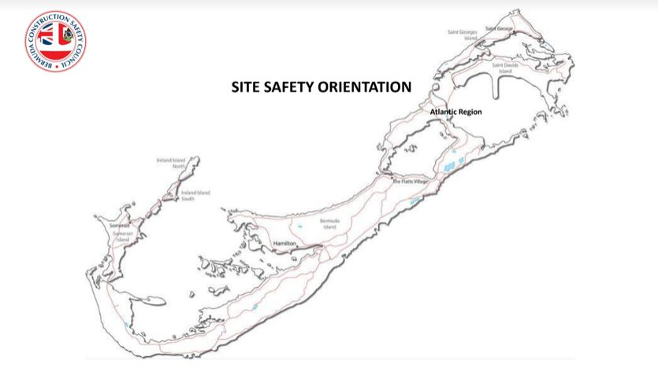
Bermuda Construction Safety Council
Overseas Affairs
2020
The Bermuda Construction Safety Council is focused on meeting the demands of the work force in all areas regarding their work life including education, work experience and healthy sporting activities. The council continues to meet at regular intervals at various locations around Bermuda with different themes and discussion topics. and differing views can be met and disputes can be settled amicably. Anyone can sit in free of charge and have their voice heard as well as have their questions answered by local officials and authorities whom have supported those types of initiatives.
The council has open talks with professionals in the Caribbean, North American, Europe and Africa to stay current expand our communication horizons. We encourage access to continued education courses at Bermuda College, Humber College, ACCA, City & Guilds, OSHA & NCCER. Many of us have paid large sums of money into institutions and associations for certificates, diplomas and degrees and after completion we face the dilemma of how to get a job without experience and how to get experience without a job.
Bermuda has a high quality of tradesmanship whom have been revered by overseas employers, however, Bermuda has a very low population than that of other countries. Naturally, there is much focus on profit making especially in a countries with high expenses but also we must focus on every aspect leading up to productivity. It is also noted as having a high level of educated individuals however more and more qualified Bermudians are being laid off without employment or are being forced to work in occupations outside of our education. It is imperative that we are able to showcase our talents locally and internationally along side other workman.
We maintain healthy overseas relations with our American and British employers who have invited us to work with them because of the impression we left on them in the working environment as well as with our Caribbean neighbors whom share in our efforts to improve island safety culture and workforce demand. Many of the Caribbean islands have become successful by adopting our model and now have become major players in the global market and if we are to maintain our competitive advantage we must reinvent ourselves according to the times.
Bermuda is known to have a high quality of legislation however that information doesn’t always reach the day to day worker. We have made it our business to answer the questions of workers that have no other voice other than that of the council and to show positive recognition for workers positive contribution.
Flora Duffy, Nikki Bascome, Naki Wells are all revered because they continue to compete and also dominate on the world stage just as Clarence “Nikky” Saunder, Clarence Hill and Clyde Best did before them. Not to say they wouldn’t be as talented if they remained in Bermuda but we must follow the footsteps of leaders such as Earl Cameron, Lois Brown Evans, Dr. Saul. We must put more faith in our schools and college government. We must grow our own culture and embrace change and support our current leaders Genesis Lynea, Dr. Kyuan Brown, David Burt.
We believe that excellence in Occupational Health, Safety & Environment is a philosophy inherent to how we do business in all aspects of our operations. We recognize our most important assets are our people, and that production, quality, and cost-effectiveness can be achieved through the daily integration of our Safety Management Systems and processes.

Slide 9
Law
Bermuda Construction Safety Council
2020
The Occupational Safety and Health Act 1982
The Occupational Safety and Health Regulations 2009

